Slide 1


Exploring the Noise in the City that Never Sleeps

Slide 2
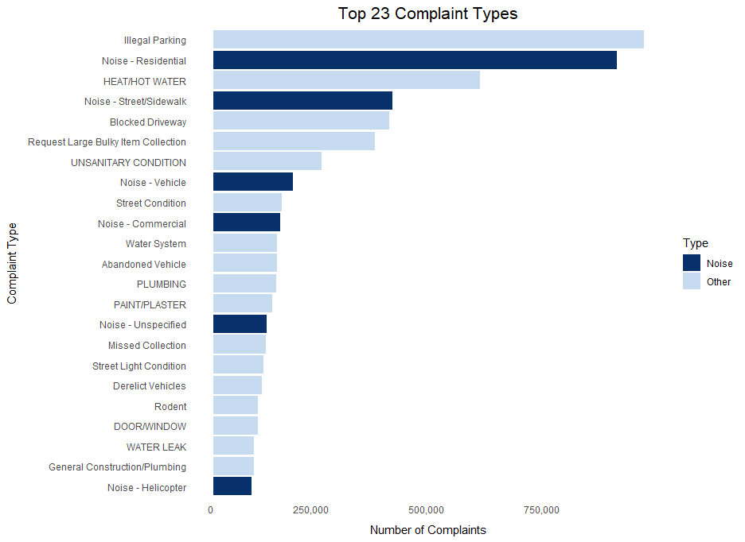
Of the top twenty-three complaints, six are noise related (about 26%).
Top 23 Complaint Types

Slide 3
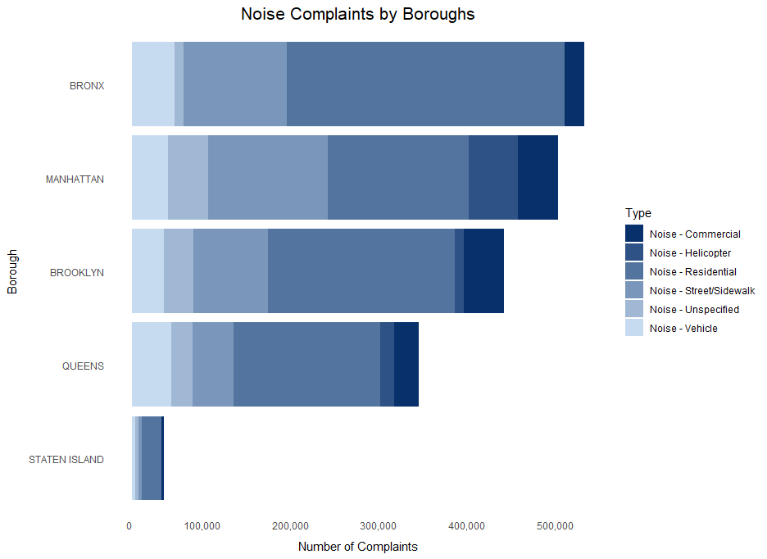
Noise Complaints by Boroughs

Slide 4
